Slide 1
Acids and Bases
Acid-Base Neutralisation
Buffers
Acid-Base Titration

Slide 2
Neutralisation Reactions
When acid and bases with equal amounts of hydrogen ion H⁺ and hydroxide ions OH⁻ are mixed, the resulting solution is neutral.
NaOH (aq) + HCl(aq) NaCl + H₂O
base acid salt water
Ca(OH)₂ + 2 HCl CaCl₂ + 2H₂O
base acid salt water

Slide 3
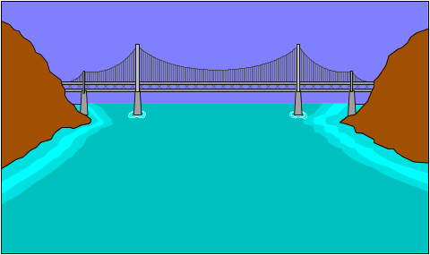
Neutralisation
H₃O⁺ and OH⁻ combine to produce water
H₃O⁺ + OH⁻ ⎯→ 2 H₂O
from acid from base neutral
Net ionic equation:
H⁺ + OH⁻ ⎯→ H₂O

Slide 4
Ionic Equations for Neutralisation
Write strong acids, bases, and salt as ions
H⁺ + Cl⁻ + Na⁺ + OH⁻ Na⁺ + Cl⁻ + H₂O
Cross out matched ions
H⁺ + Cl⁻ + Na⁺ + OH⁻ Na⁺ + Cl⁻ + H₂O
Write a net ionic reaction
H⁺ + OH⁻ H₂O

Slide 5
Balancing Neutralisation Equations
Write the equation for the Neutralisation between magnesium hydroxide and nitric acid.
1. Write the formulas of the acid and base
Mg(OH)₂ + HNO₃
2. Balance to give equal OH⁻ and H⁺
Mg(OH)₂ + 2 HNO₃

Slide 6
3. Write the products:
Mg(OH)₂ + 2HNO₃ Mg(NO₃)₂ + H₂O
salt water
(metal and nonmetal)
4. Balance products
Mg(OH)₂ + 2 HNO₃ Mg(NO₃)₂ + 2 H₂O

Slide 7
Learning Check N2
Select the correct group of coefficients for the following Neutralisation equations
A. __ HCl + __ Al(OH)₃ __AlCl₃ + __ H₂O
1) 1, 3, 3, 1 2) 3, 1, 1, 1 3) 3, 1, 1 3
B.__ Ba(OH)₂ + __H₃PO₄ __Ba₃(PO₄)₂ + __ H₂O
1) 3, 2, 2, 2 2) 3, 3, 1, 6 3) 3, 2, 1, 6

Slide 8
Solution N2
A. 3HCl + 1Al(OH)₃ 1AlCl₃ + 3H₂O
B. 3Ba(OH)₂ + 2H₃PO₄ 1Ba₃(PO₄)₂ + 6H₂O

Slide 9
Learning Check N3
Write a balanced equation and calculate the mL of 2.00 M H₂SO₄ required to neutralize 50.0 mL of 1.00 M KOH?
___H₂SO₄ +___KOH ___K₂SO₄+ H₂O
1) 12.5 mL 2) 50.0 mL 3) 200. mL

Slide 10
Solution N3
How many mL of 2.00 M H₂SO₄ are required to neutralize 50.0 mL of 1.00 M KOH?
H₂SO₄ + 2KOH K₂SO₄ + 2H₂O
0.0500 L x 1.00 mole KOH x 2.00M H₂SO₄ 1 L KOH ? L KOH
= 12.5mL

Slide 11
Learning Check N4
A 25 mL sample of phosphoric acid is neutralized by 40. mL of 1.5 M NaOH. What is the molarity of the phosphoric acid solution?
3NaOH + H₃PO₄ Na₃PO₄ + 3H₂O
1) 0.45 M 2) 0.80 M 3) 7.2 M

Slide 12
Solution S4
0.040 L x 1.5 mole NaOH x 1 mole H₃PO₄
1 L 3 mole NaOH
x 1 =0.80 mol/L = 0.80 M
0.025 L

